Slide 1
ITEC100 – Week 6 Excel Associate 365 Review 1 Testing
Tutor: Dr. Farshid Keivanian

Slide 2
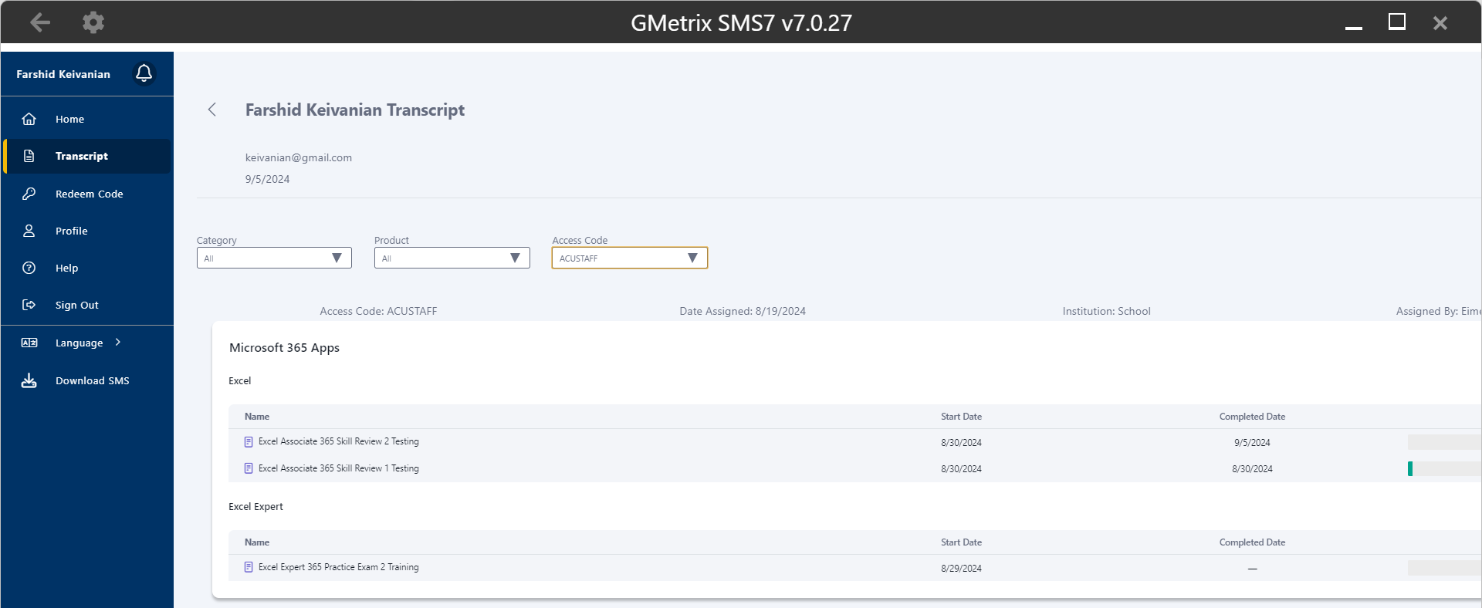
Excel Associate 365 Review 1

Slide 3
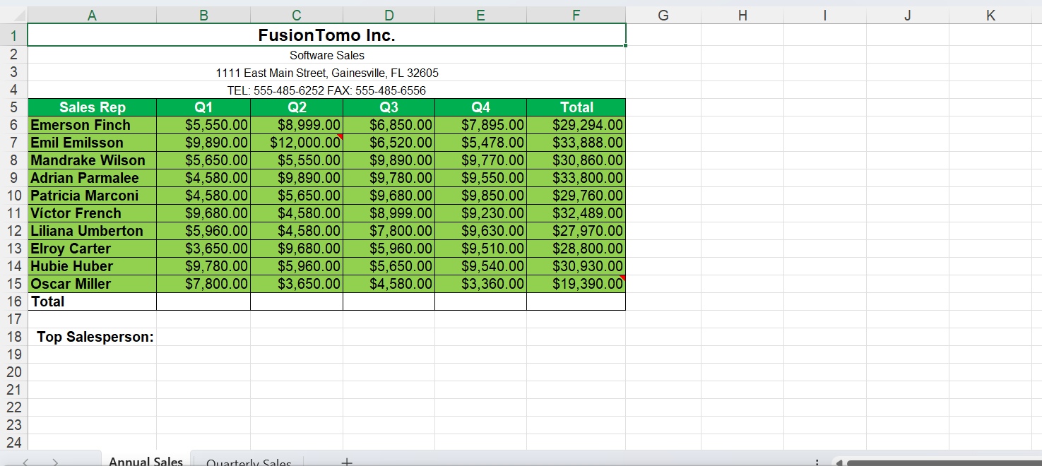
Excel Associate 365 Review 1
In the Annual Sales worksheet, use the Find & Select tool to find the cell in the open spreadsheet that contains Conditional Formating and apply a Thick Outside Border.

Slide 4
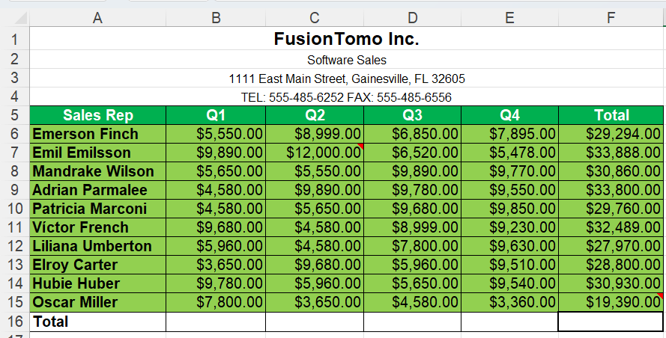
Excel Associate 365 Review 1
1. Go to the "Annual Sales" Worksheet:
Click on the tab named "Annual Sales" at the bottom of the Excel window.
2. Use the Find & Select Tool:
On the Ribbon, go to the Home tab.
In the Editing group, click on Find & Select.
From the drop-down menu, select Conditional Formatting.
3. Find the Cell with Conditional Formatting:
Excel will highlight the cell(s) that contain Conditional Formatting. This is the cell you need to modify.

Slide 5
Excel Associate 365 Review 1
4. Apply a Thick Outside Border:
With the cell selected, go to the Home tab.
In the Font group, click on the drop-down arrow next to the Borders icon.
From the list, select Thick Outside Borders.
5. Save Your Work:
Save the Excel file by pressing Ctrl + S or by clicking on the Save icon.

Slide 6
Excel Associate 365 Review 1
Use the AutoSum tool to get the SUM of the values for each cell (B through F) in the Total row.

Slide 7
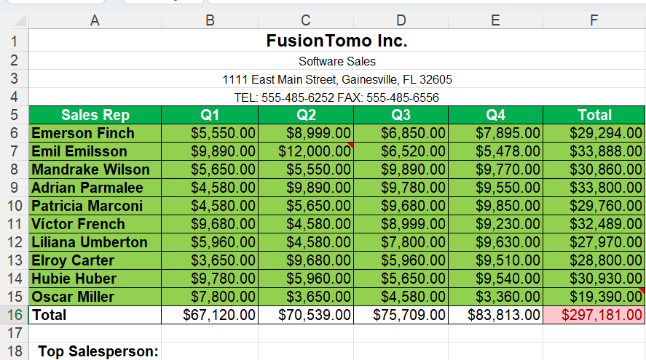
Excel Associate 365 Review 1
1. Select the Cell in the Total Row (Column B):
Click on cell B16 (the cell directly below the Q1 column values in the Total row).
2. Use the AutoSum Tool:
While cell B16 is selected, go to the Home tab on the Ribbon.
In the Editing group, find and click the AutoSum button (Σ symbol).
Excel will automatically select the range of cells above it (B5 through B15). Press Enter to confirm the sum.

Slide 8
Excel Associate 365 Review 1
3. Repeat for Columns C through F:
Repeat the above steps for each of the following cells: C16, D16, E16, and F16.
For each cell, select the corresponding cell in the Total row and use the AutoSum tool to calculate the sum of the values above it.
4. Review the Results:
After performing these steps, cells B16 through F16 should display the total sums for each respective column.

Slide 9
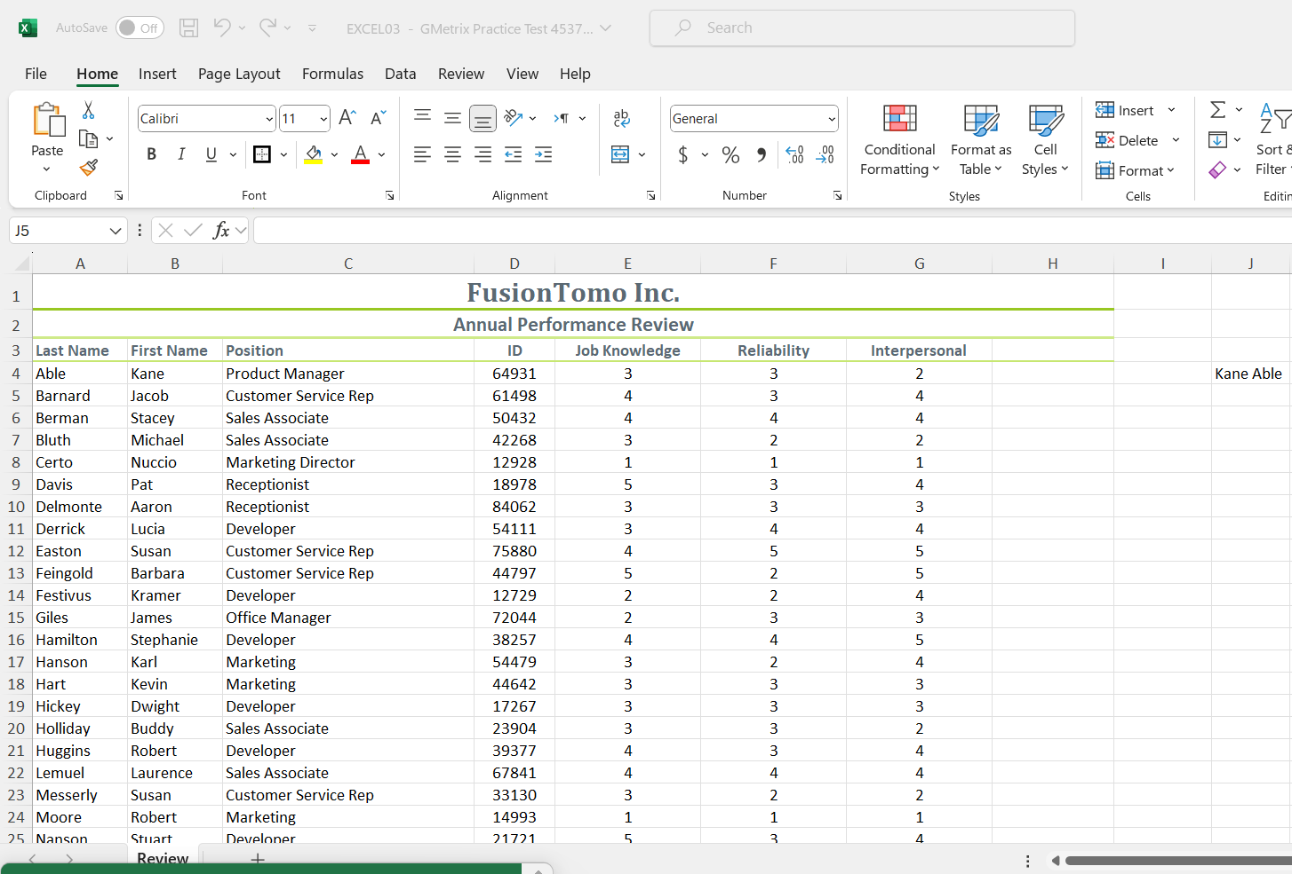
Excel Associate 365 Review 1
In the Review worksheet, use the CONCATENATE function to display the contents of cell B4 and A4 separated by a space in cell J4.
1. Select Cell J4:
Click on cell J4 in the "Review" worksheet.
2. Enter the CONCATENATE Function:
In cell J4, enter the following formula:
excel
= CONCATENATE(B4, " ", A4)
This formula combines the content of cell B4 and cell A4, with a space (" ") between them.

Slide 10
Excel Associate 365 Review 1
In the Review worksheet, use the CONCATENATE function to display the contents of cell B4 and A4 separated by a space in cell J4.
3. Press Enter:
After typing the formula, press Enter.
The result in cell J4 should now display the content of B4 and A4 separated by a space.
Explanation:
The CONCATENATE function is used to join two or more text strings into one string.
" " adds a space between the content of B4 and A4.

Slide 11
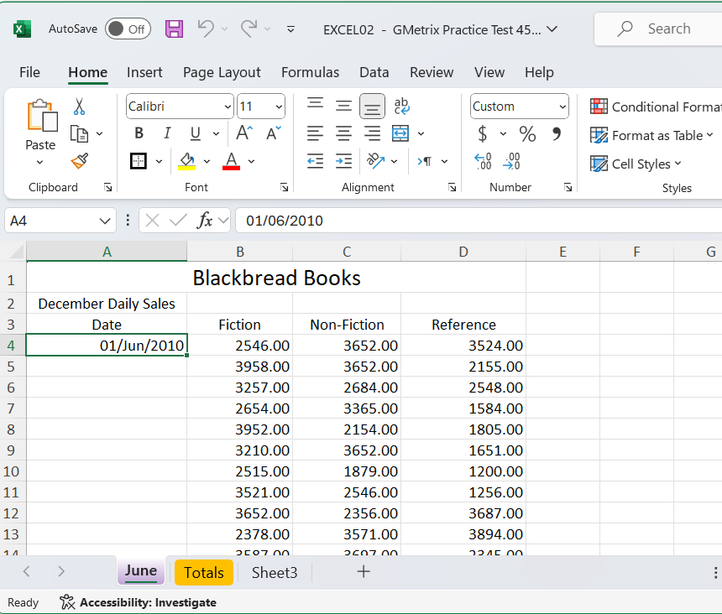
Excel Associate 365 Review 1
In the June worksheet, use Autofill to extend the series starting in the cell A4 to the cell A33.
1. Select the Starting Cell:
Click on cell A4, which contains the date "01/Jun/2010."
2. Use the Autofill Handle:
Move your cursor to the bottom-right corner of cell A4 until it changes to a small black cross (this is the Autofill handle).

Slide 12
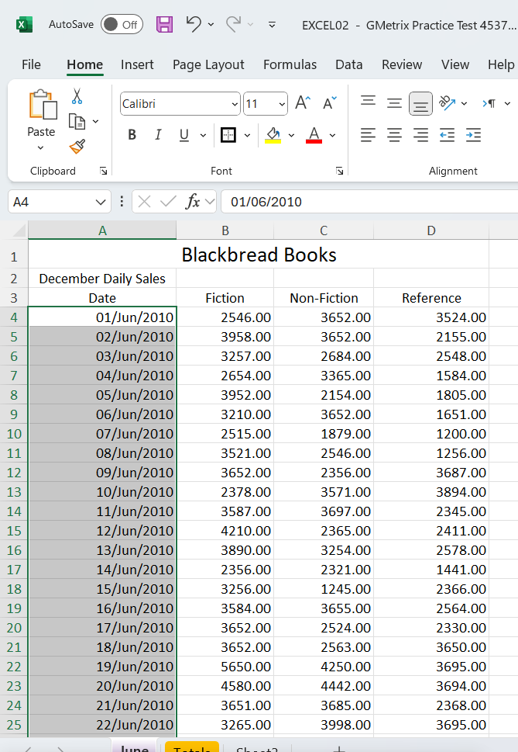
Excel Associate 365 Review 1
In the June worksheet, use Autofill to extend the series starting in the cell A4 to the cell A33.
3. Drag Down to Extend the Series:
Click and hold the left mouse button on the Autofill handle and drag it down to cell A33.
As you drag down, Excel will automatically fill in the dates in sequence.
4. Release the Mouse Button:
Once you reach cell A33, release the mouse button. The dates should now be filled in, continuing the series from A4.

Slide 13
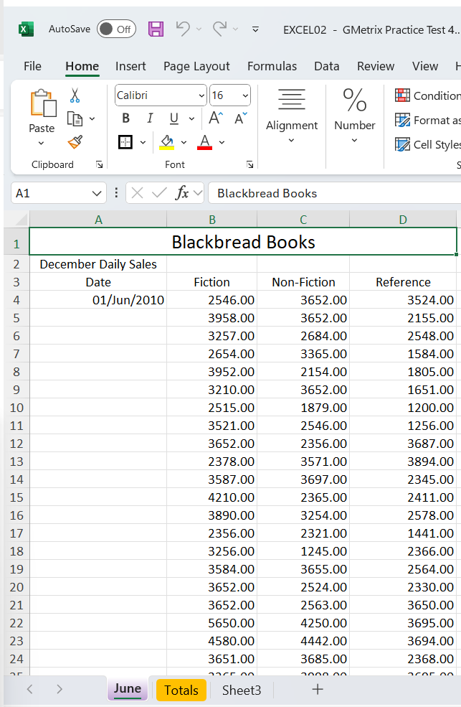
Excel Associate 365 Review 1
In the June worksheet, apply Table Style Light 4 to the cells A3 through D34.
1. Select the Range of Cells:
Click and drag to select the cells from A3 to D34 in the "June" worksheet.
2. Convert the Range to a Table:
Go to the Insert tab on the Ribbon.
Click on Table. Excel will automatically detect the range you've selected.
Ensure the checkbox for My table has headers is checked since your selection includes headers in row 3 (Date, Fiction, Non-Fiction, Reference).
Click OK to convert the range to a table.

Slide 14
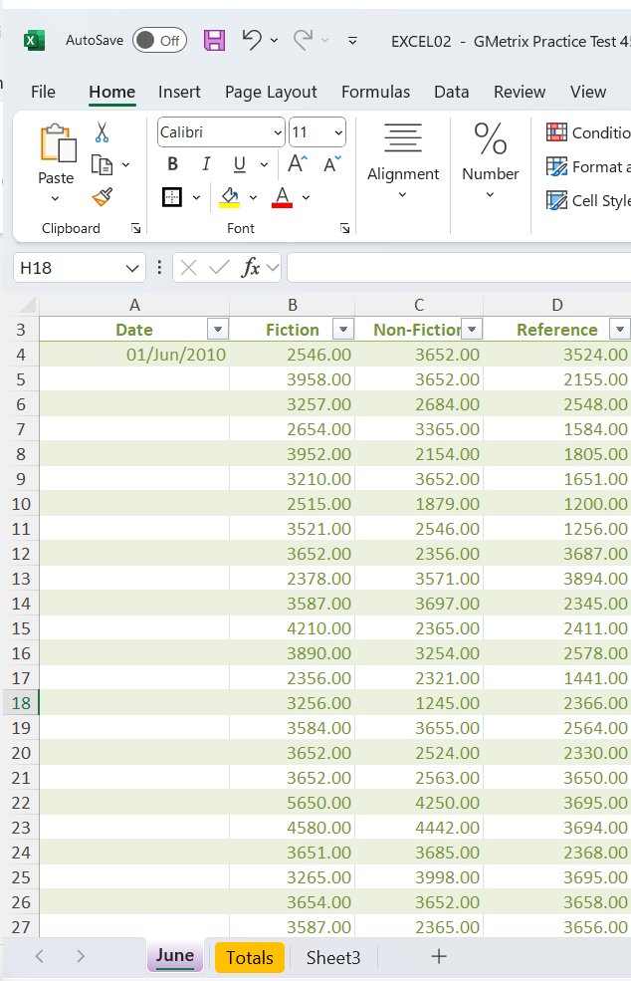
Excel Associate 365 Review 1
In the June worksheet, apply Table Style Light 4 to the cells A3 through D34.
3. Apply Table Style Light 4:
With the newly created table still selected, go to the Table Design tab on the Ribbon (this tab appears only when the table is selected).
In the Table Styles group, click the drop-down arrow to see more styles.
Scroll through the list of styles and select Table 4 Style Light 4.
4. Review the Table:
Your selected range should now be formatted using the "Table Style Light 4" style, with alternating light-colored rows and formatted headers.

Slide 15
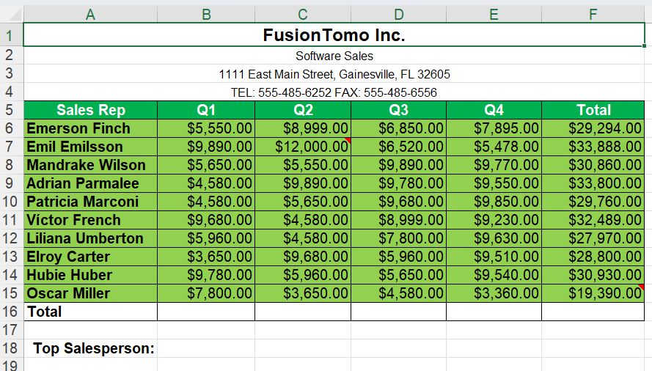
Excel Associate 365 Review 1
In the Annual Sales worksheet, apply a Link to the title FusionTomo Inc. that links to the website www.fusiontomo.com
3. Apply Table Style Light 4:
With the newly created table still selected, go to the Table Design tab on the Ribbon (this tab appears only when the table is selected).
In the Table Styles group, click the drop-down arrow to see more styles.
Scroll through the list of styles and select Table 4 Style Light 4.
4. Review the Table:
Your selected range should now be formatted using the "Table Style Light 4" style, with alternating light-colored rows and formatted headers.

Slide 16
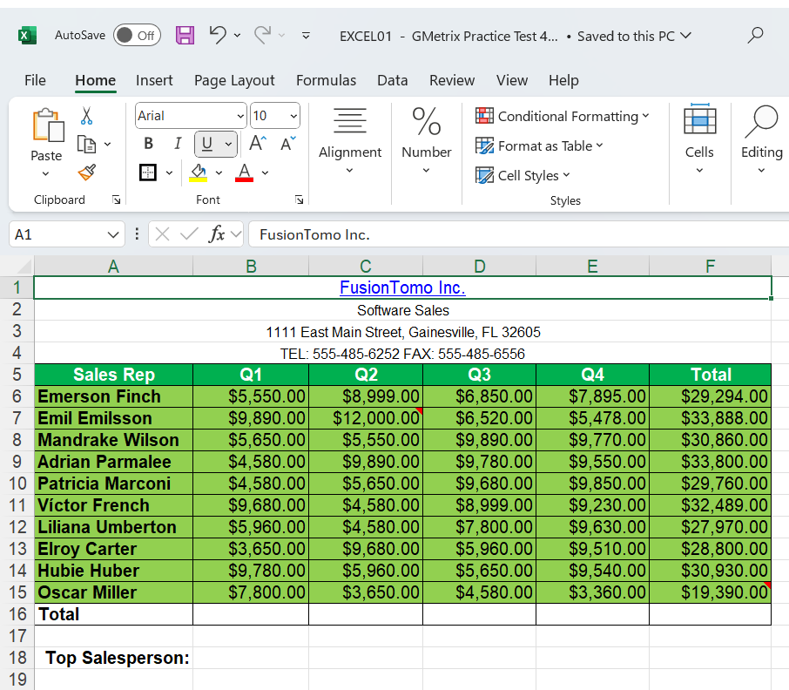
Excel Associate 365 Review 1
In the Annual Sales worksheet, apply a Link to the title FusionTomo Inc. that links to the website www.fusiontomo.com
1. Select the Cell Containing the Title:
Click on cell A1 where the title "FusionTomo Inc." is located.
2. Insert the Hyperlink:
Right-click on cell A1 and select Link from the context menu. Alternatively, you can go to the Insert tab on the Ribbon and click on Link.

Slide 17
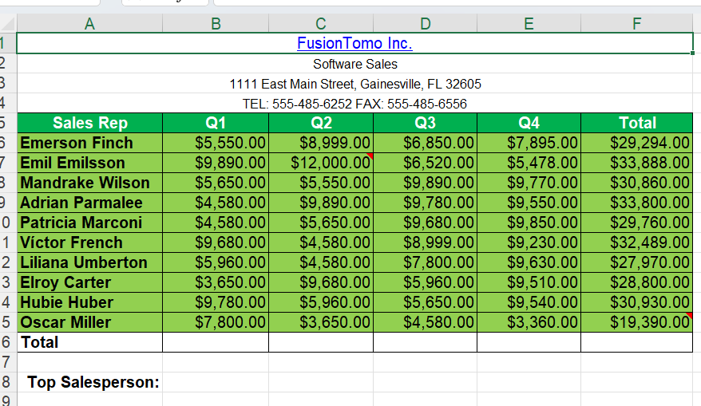
Excel Associate 365 Review 1
In the Annual Sales worksheet, apply a Link to the title FusionTomo Inc. that links to the website www.fusiontomo.com
3. Add the Website URL:
In the dialog box that appears, type the URL http://www.fusiontomo.com in the Address field.
Ensure that the Text to display field shows "FusionTomo Inc."
4. Confirm and Apply:
Click OK to apply the hyperlink.

Slide 18
Excel Associate 365 Review 1
In the Annual Sales worksheet, apply a Link to the title FusionTomo Inc. that links to the website www.fusiontomo.com
5. Verify the Link:
The title "FusionTomo Inc." in cell A1 should now be a clickable hyperlink that takes you to www.fusiontomo.com when clicked.

Slide 19
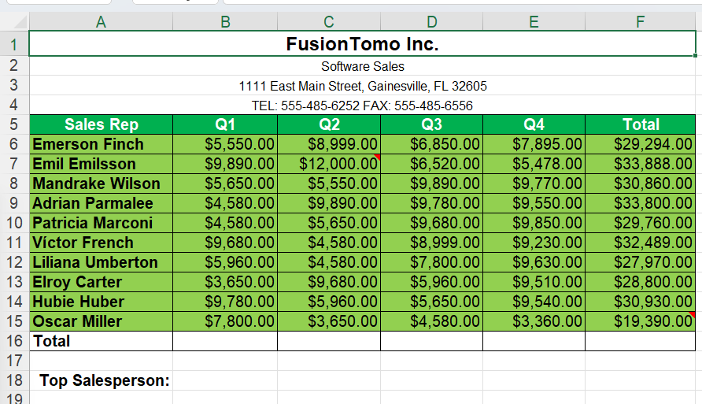
Excel Associate 365 Review 1
In cell range B16:F16 set the style of the cell with the following characteristics: Number Format = Currency, Font = Courier New, Fill Color = Yellow.
1. Select the Cell Range:
Click and drag to select the cells from B16 to F16 in the "Annual Sales" worksheet.
2. Set the Number Format to Currency:
With the cells selected, go to the Home tab on the Ribbon.
In the Number group, click the drop-down arrow next to the Number Format box and select Currency.

Slide 20
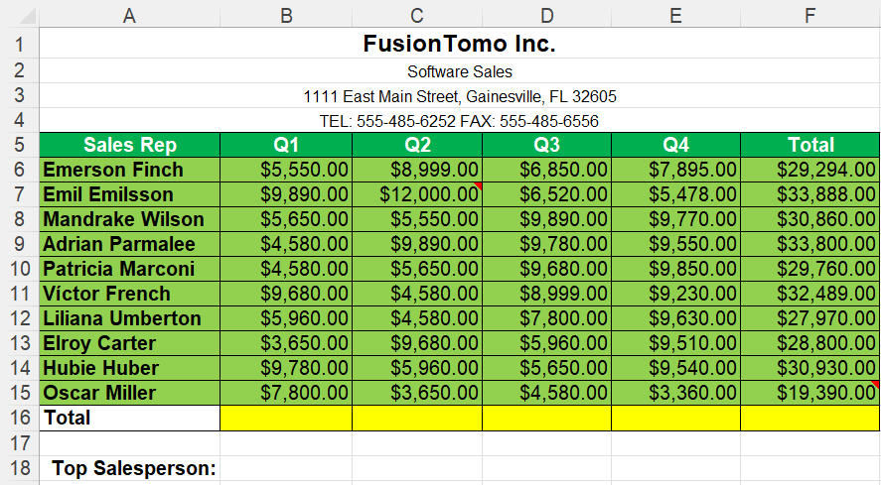
Excel Associate 365 Review 1
In cell range B16:F16 set the style of the cell with the following characteristics: Number Format = Currency, Font = Courier New, Fill Color = Yellow.
3. Change the Font to Courier New:
Still in the Home tab, go to the Font group.
Click the drop-down arrow in the Font box and select Courier New from the list.
4. Set the Fill Color to Yellow:
In the Home tab, go to the Font group.
Click the drop-down arrow next to the Fill Color icon (paint bucket) and choose Yellow from the color palette.

Slide 21
Excel Associate 365 Review 1
In cell range B16:F16 set the style of the cell with the following characteristics: Number Format = Currency, Font = Courier New, Fill Color = Yellow.
5. Review Your Changes:
The selected cells B16:F16 should now be formatted with the Currency number format, Courier New font, and a yellow fill color.

Slide 22
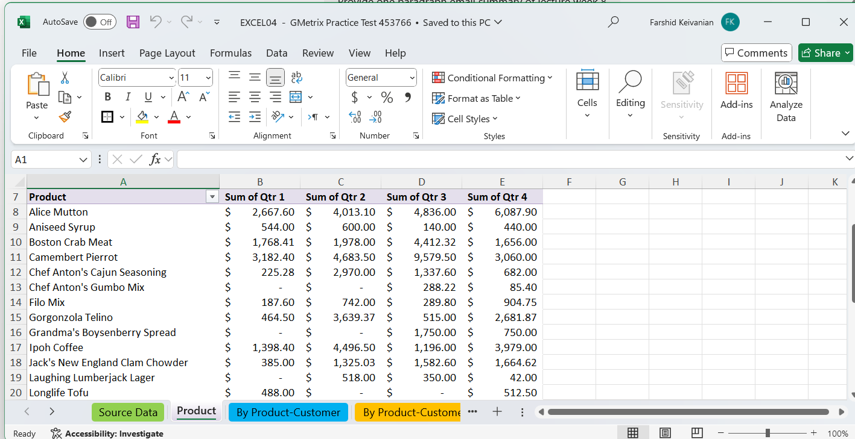
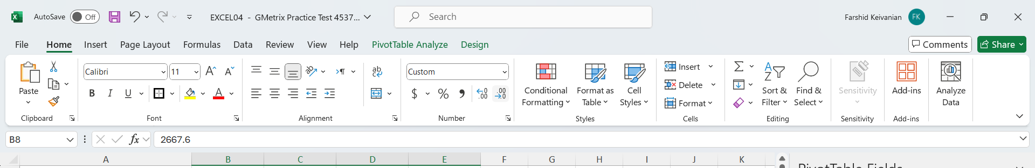
Excel Associate 365 Review 1
In the Product worksheet, change the format of the numbers in cells B8:E33 so that no decimal places are showing.
Select cells B8:E33, and in the Home tab, in the Number group, click Decrease Decimal until there are no decimals on the numbers.

Slide 23
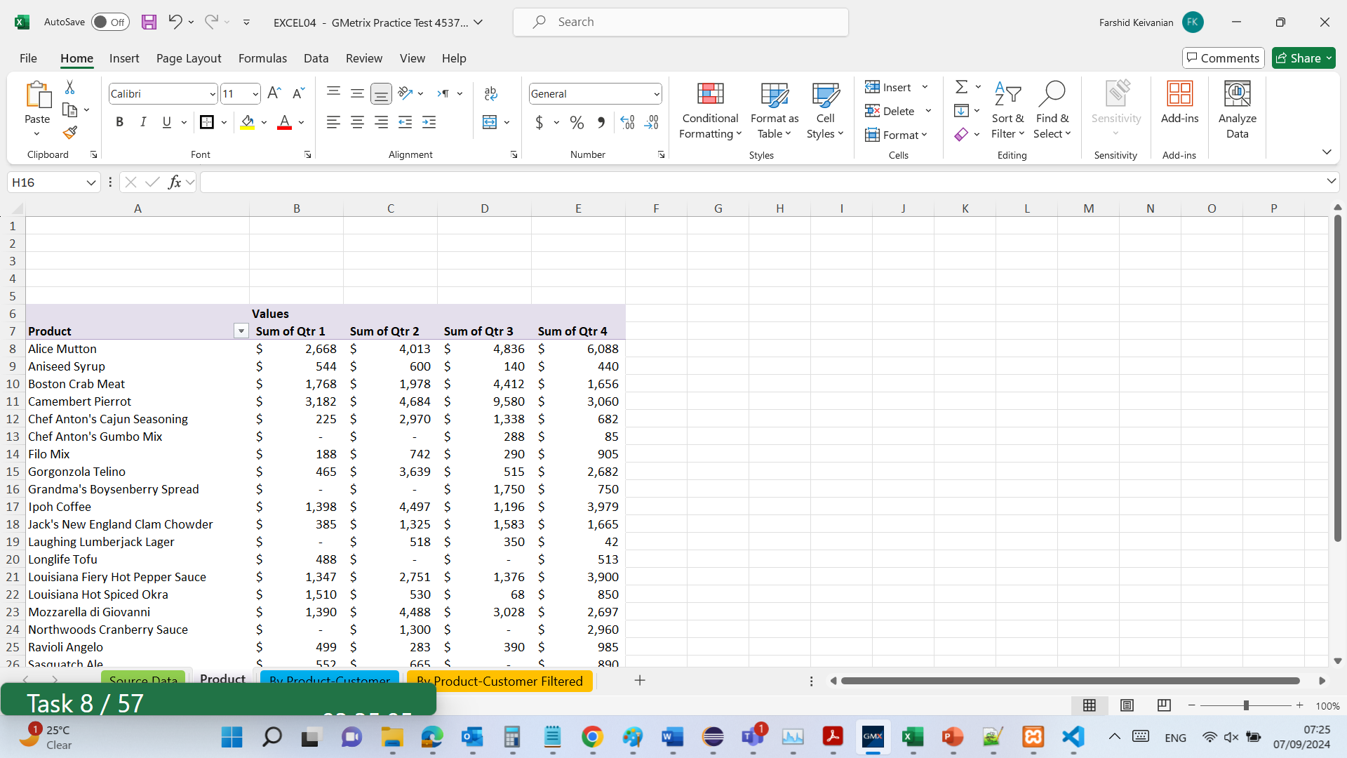
Excel Associate 365 Review 1
In the Product worksheet, change the format of the numbers in cells B8:E33 so that no decimal places are showing.

Slide 24
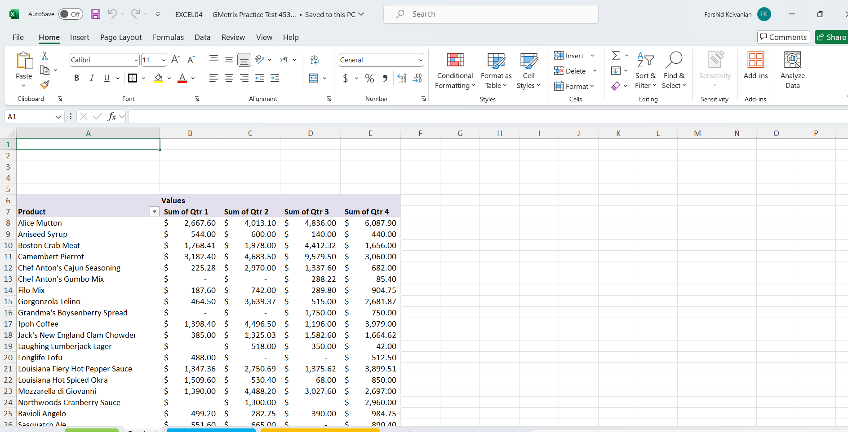
Excel Associate 365 Review 1
Change the view to the split screen view.
Click on the "View" tab in the ribbon.
In the "Window" group, click on "Split."
The screen will split into four panes. You can adjust the split by dragging the bars horizontally or vertically.

Slide 25
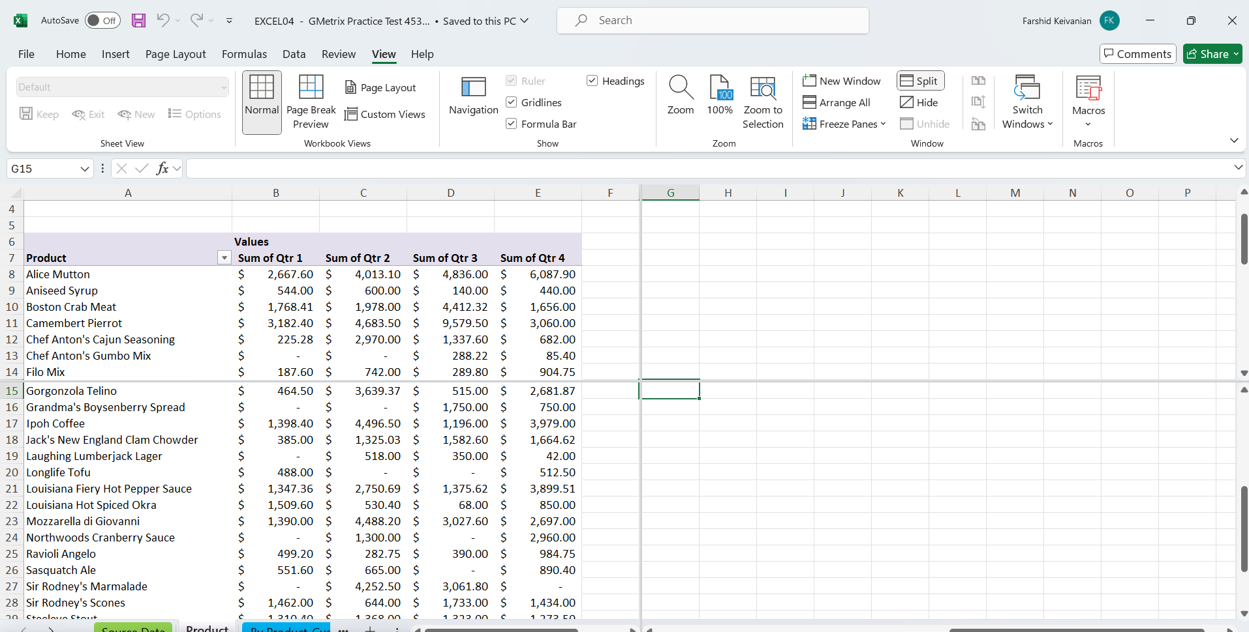
Excel Associate 365 Review 1
Change the view to the split screen view.

Slide 26
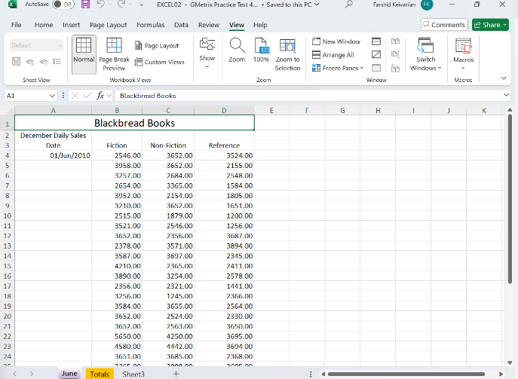
Excel Associate 365 Review 1
Merge & Align Right the content in cells A2 through D2 in the June worksheet.
Select the Cells:
Highlight cells A2 through D2 in the June worksheet by clicking and dragging across them.
2. Merge the Cells:
Navigate to the "Home" tab in the Excel ribbon.
In the "Alignment" group, click the "Merge & Center" dropdown.
Select either "Merge Across" or "Merge Cells." If you choose "Merge & Center," you will need to adjust the alignment afterward.

Slide 27
Excel Associate 365 Review 1
Merge & Align Right the content in cells A2 through D2 in the June worksheet.
3. Align the Content to the Right:
With the merged cell still selected, remain in the "Home" tab.
In the "Alignment" group, click the "Align Right" button to position the content on the right side of the merged cell. This will combine cells A2 through D2 into a single cell with the content aligned to the right.

Slide 28
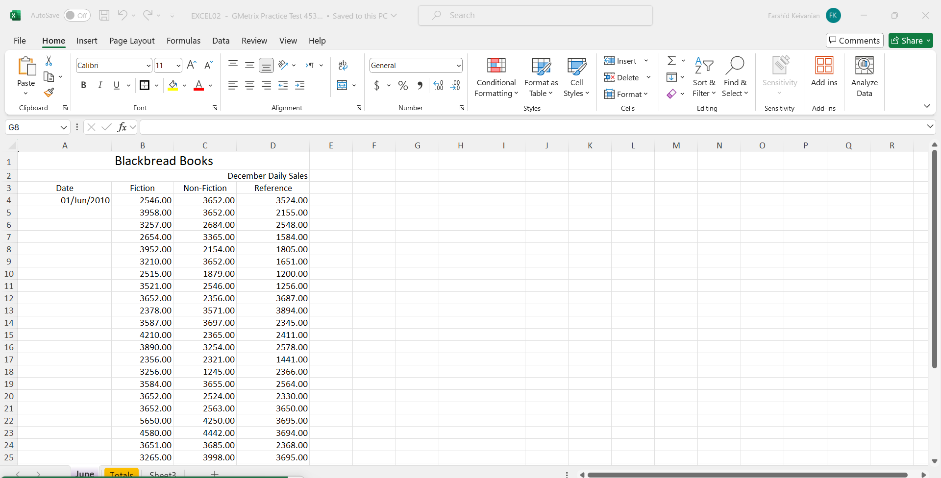
Excel Associate 365 Review 1
Merge & Align Right the content in cells A2 through D2 in the June worksheet.

Slide 29
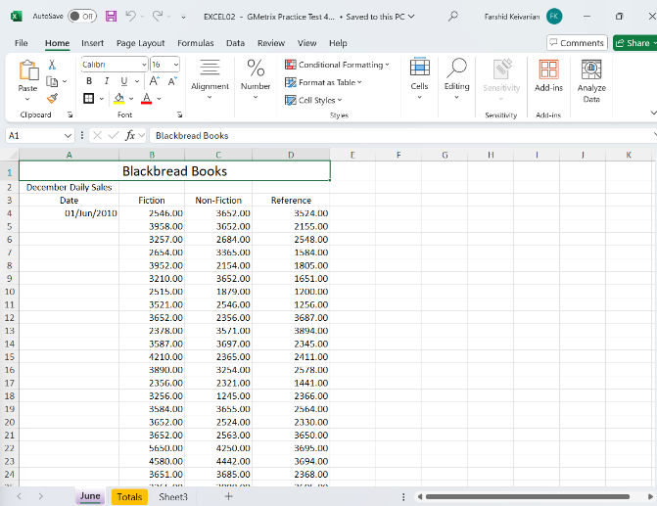
Excel Associate 365 Review 1
Apply the style Heading 3 to the title Blackbread Books.
Select the Title: Click on the cell containing the title "Blackbread Books" (likely cell A1) in the June worksheet.

Slide 30
Excel Associate 365 Review 1
Apply the style Heading 3 to the title Blackbread Books.
2. Apply Heading 3 Style:
Go to the "Home" tab in the Excel ribbon.
In the "Styles" group, click on "Cell Styles".
A dropdown menu will appear with various styles. Scroll down to find "Heading 3".
Click on "Heading 3" to apply the style to the selected cell. This will format the title "Blackbread Books" using the predefined "Heading 3" style.

Slide 31
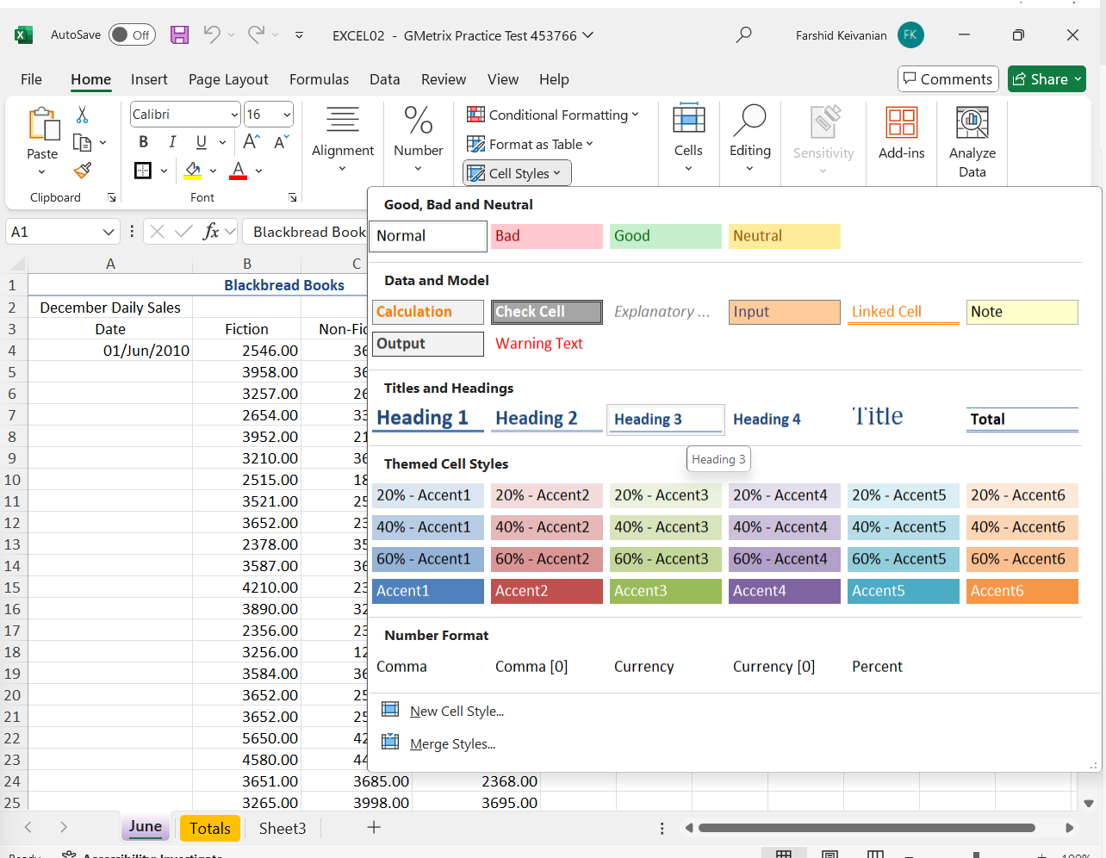
Excel Associate 365 Review 1
Apply the style Heading 3 to the title Blackbread Books.

Slide 32

Submit the Excel Associate 365 'Skill Reviews 1 and 2. Make sure your name, data, and score is visible in the screenshots.
Thank you
Dr. Farshid Keivanian

